Slide 1

HOME CREDIT DEFAULT RISK
OUTLINE
Introduction
Methods Review
Data Cleaning and Restructuring
Statistical Analysis and Data Exploration
Methods and Tools of Use
Results & Conclusion
Resources and References
Berk Filcan
Mehmet Akif Güçlü
Nihal Temüge
Beyza Yakıcı
Büşra Yavuz

Slide 2

Introduction
Credit risk is the possibility of losing a lender takes on due to the possibility of a borrower not paying back a loan.
Consumer credit risk can be measured by the five Cs:
credit history
capacity to repay
capital
the loan's conditions
associated collateral.
Aim: to predict whether or not an applicant will be able to repay a loan by using historical loan application data
Notes:
Aim’den önce krizlerden bahsedelim

Slide 3
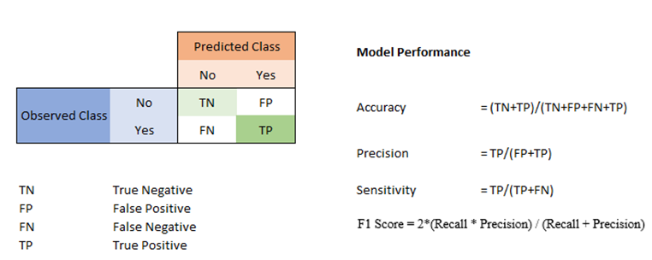
Methods Review
Methods:
Logistic Regression
K-Nearest Neighbour Algorithm
Random Forest Classifier
Performance Measurements:
Cross validation score
Learning curve
ROC-AUC
Confusion matrix
Accuracy, precision, recall (sensitivity), F1 score
Notes:
Random forest için polynomial da bakıyoruz
We use confusion matrix for accuracy, precision, recall, F1

Slide 4
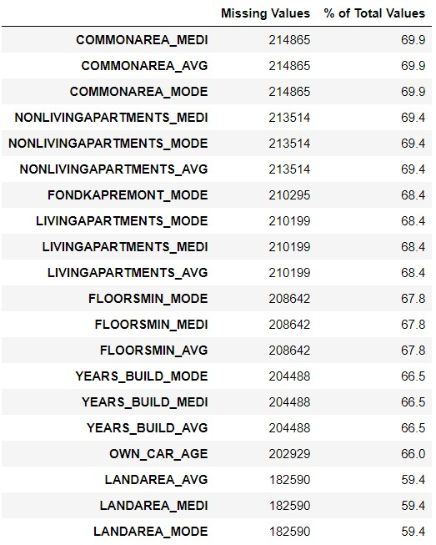
Data Cleaning and Restructuring
Source:
https://www.kaggle.com/c/home-credit-default-risk/data
Important Feature List:
EXT_SOURCE1, EXT_SOURCE2, EXT_SOURCE3
DAYS_EMPLOYED
DAYS_BIRTH
NAME_EDUCATION_TYPE
OCCUPATION_TYPE
CODE_GENDER
NAME_INCOME_TYPE
CNT_CHILDREN
AMT_INCOME_TOTAL
Notes:
Missing value’ları çıkarıyoruz column 57%’den çok boş olanları çünkü EXT_SOURCE1 56% boş ama correlation yüksek, lazım olabilir, tutalım dedik

Slide 5
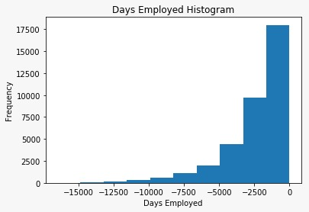
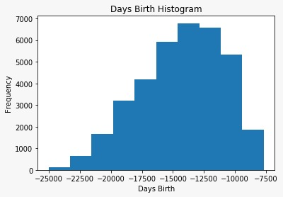
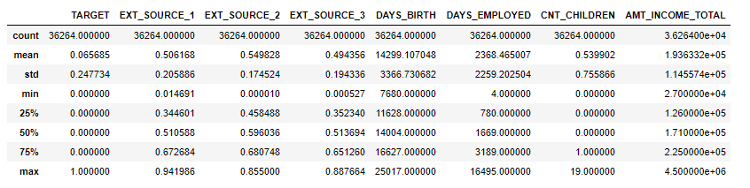
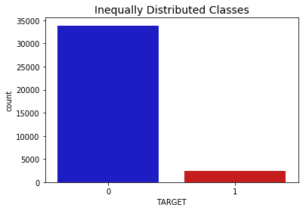
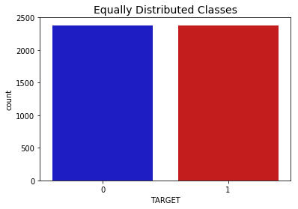
Histograms of DAYS_EMPLOYED and DAYS_BIRTH:
Description of the subsample:
Barplots of the original dataframe and the undersample dataframe:
Notes:
En son encode ladık

Slide 6
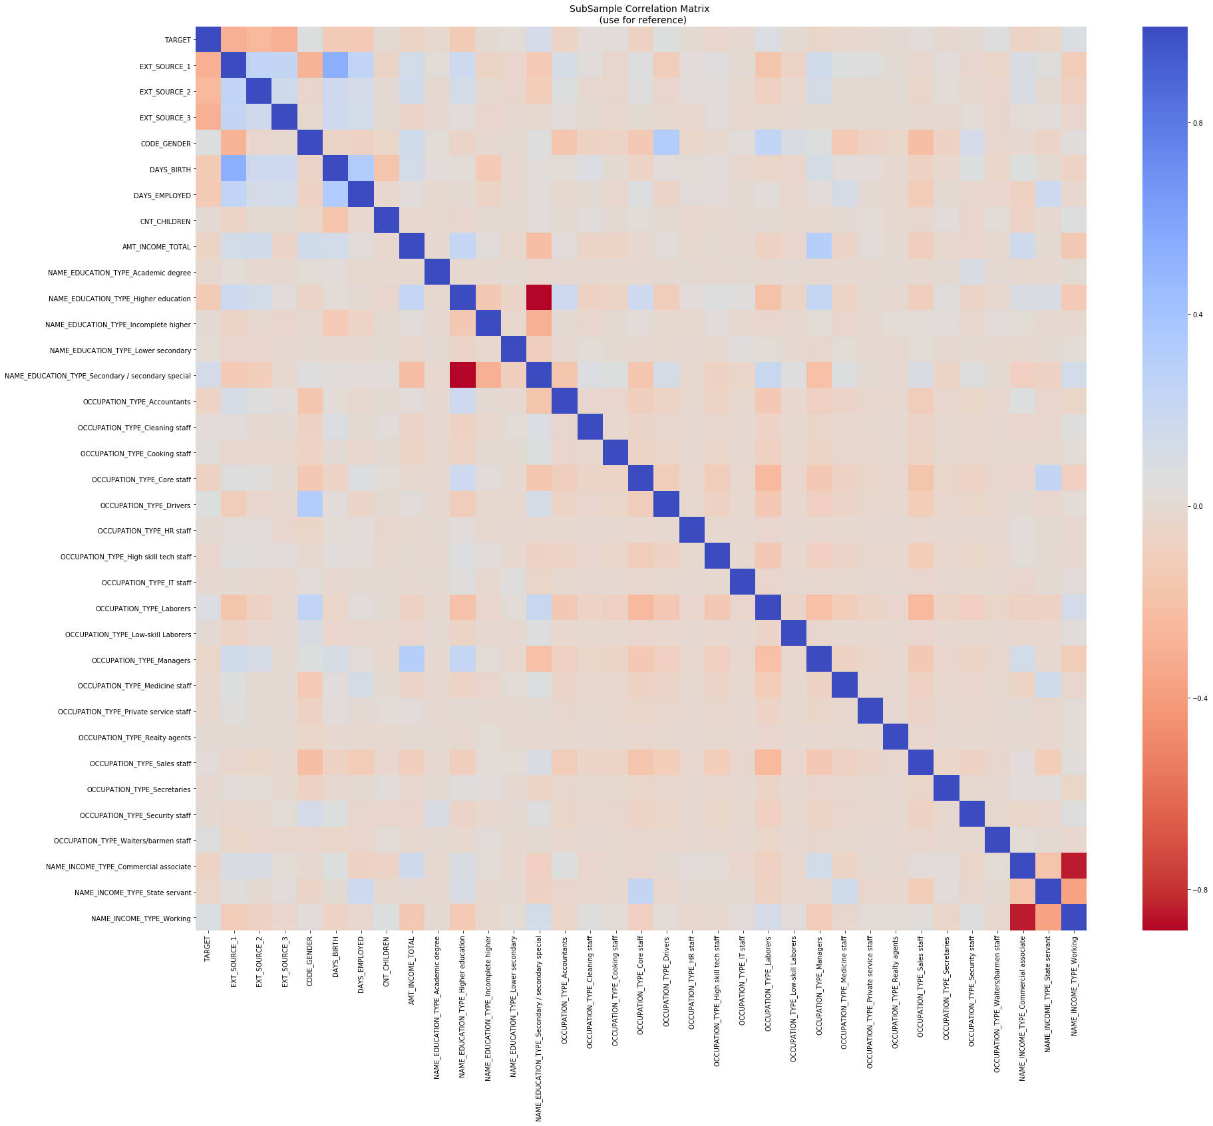
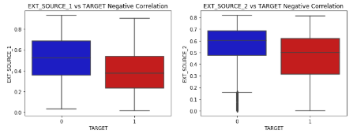
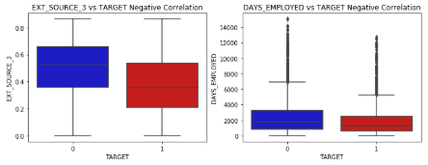
Statistical Analysis and Data Exploration
Notes:
Outlier var mı diye fazla korale olanlarda boxplot baktık, TARGET=1’de fazla outlier yok o yüzden bununla ilgili bi işlem yapmadık

Slide 7


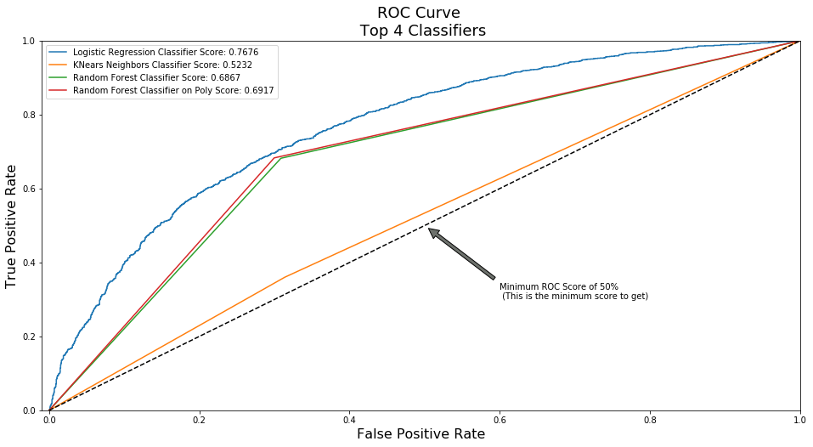
Methods and Tools of Use
Cross validation score:
Cross validation score after GridSearch:
ROC Curve:

Slide 8
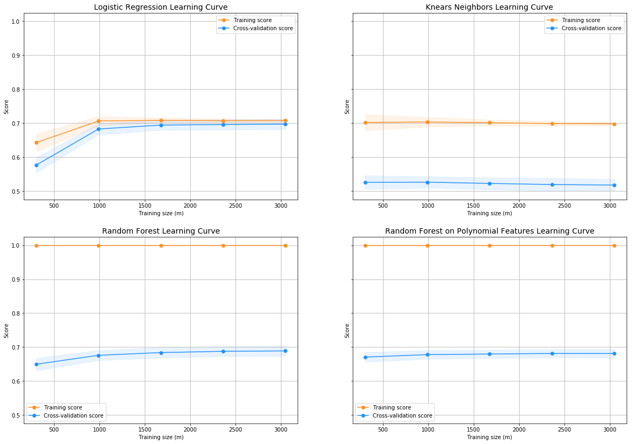

Slide 9
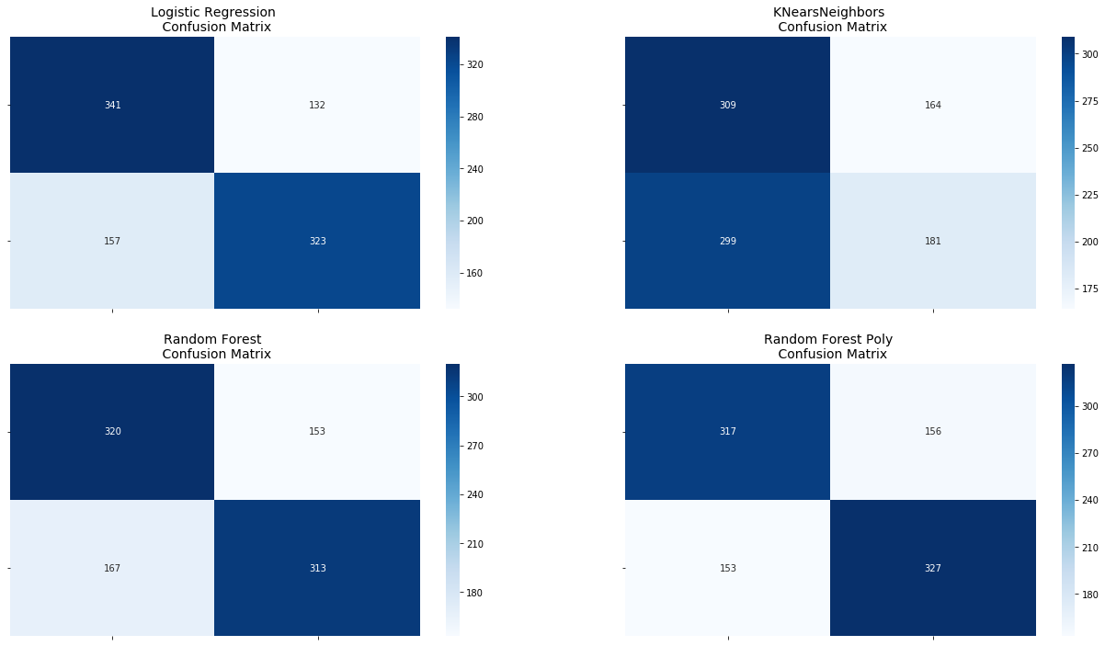
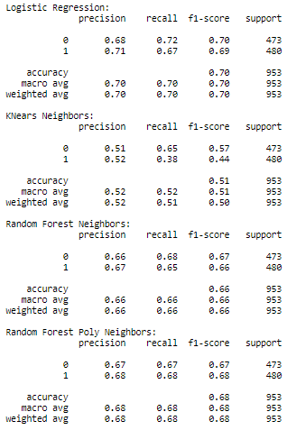

Slide 10



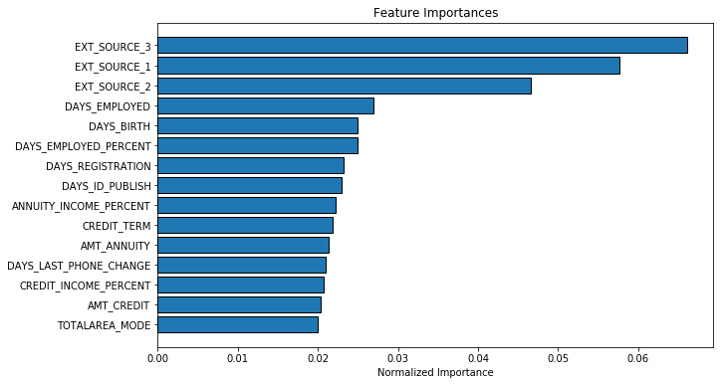
Results & Conclusion
THE WINNER: LOGISTIC REGRESSION
'CREDIT_INCOME_PERCENT’
'ANNUITY_INCOME_PERCENT’
'CREDIT_TERM’
'DAYS_EMPLOYED_PERCENT’
made it into the top 15 most important features.

Slide 11

Resources and References
"Bank Loan Default Prediction." Kaggle. Accessed July 16, 2019. https://www.kaggle.com/zhunqiang/bank-loan-default-prediction?scriptVersionId=7634496.
Bozkurt, Gul Efsan. Feature Selection and Transfer Learning Algorithms with Applications on Credit Risk Analysis. Master's thesis, Bogazici University, 2012. Accessed July 31, 2019. https://en.academicresearch.net/feature-selection-and-transfer-learning-algorithms-with-applications-on-credit-risk-analysis/.
Butaru, Florentin, Qingqing Chen, Brian Clark, Sanmay Das, Andrew Lo, and Akhtar Siddique. "Risk and Risk Management in the Credit Card Industry." 2015.
"Credit Fraud || Dealing with Imbalanced Datasets." Kaggle. Accessed July 20, 2019. https://www.kaggle.com/janiobachmann/credit-fraud-dealing-with-imbalanced-datasets.
Donnelly, Catherine, and Paul Embrechts. "The Devil Is in the Tails: Actuarial Mathematics and the Subprime Mortgage Crisis." ASTIN Bulletin40, no. 1 (2010).
Eichengreen, Barry, and Kris James Mitchener. "The Great Depression as a Credit Boom Gone Wrong." SSRN Electronic Journal, 2003.
"Home Credit Default Risk." Kaggle. Accessed June 25, 2019. https://www.kaggle.com/c/home-credit-default-risk/data.
James, Gareth. An Introduction to Statistical Learning: With Applications in R. New York: Springer, 2017.
Kruppa, Jochen, Alexandra Schwarz, Gerhard Arminger, and Andreas Ziegler. "Consumer Credit Risk: Individual Probability Estimates Using Machine Learning." Expert Systems with Applications40, no. 13 (2013).
Lantz, Brett. Machine Learning with R: Discover How to Build Machine Learning Algorithms, Prepare Data, and Dig Deep into Data Prediction Techniques with R. Birmingham: Packt Publishing, 2013.
Luo, Cuicui, Desheng Wu, and Dexiang Wu. "A Deep Learning Approach for Credit Scoring Using Credit Default Swaps." Engineering Applications of Artificial Intelligence65 (December 2016).
Sengupta, Arindam. "A First Course in Machine Learning by Simon Rogers and Mark Girolami." International Statistical Review82, no. 1 (2014).
"Start Here: A Gentle Introduction." Kaggle. Accessed June 25, 2019. https://www.kaggle.com/willkoehrsen/start-here-a-gentle-introduction.

